Slide 1


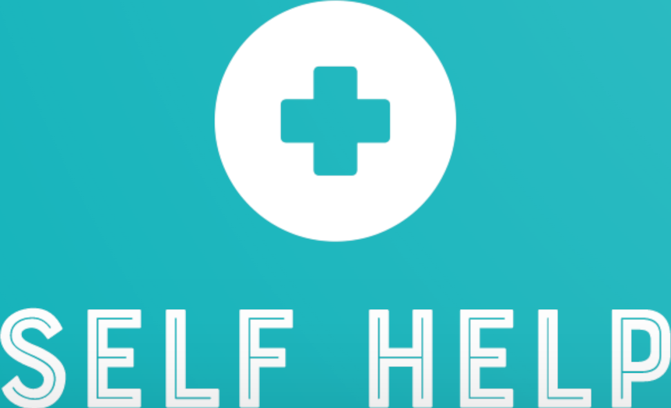



Self Help
Mental Health Awareness
App to Improve Your Mental Health
Interactive Chat Help
Reliable Self Checker
“Amazing, mind-blowing and life changing!”
- Anonymous

Slide 2



What Is Self Help?
Self Help is an easier, faster way to help manage mental health symptoms.
It is critical to everyday life as it provides an user-friendly interface to directly answer the patient concerns better than any other app
This unique app plans to improve people’s mental health by having a easy, fast self-checker for symptoms/feelings that will then output related conditions and helpful remedies.
In addition, the app features a peer-peer chat room feature that allows users to engage in pseudo-group-counseling from the comfort of the app
Notes:
Self help is an app where users enter in their feelings / mental health symptoms, and it assembles a plan to help them improve their mental health. In addition to this, our app also features a peer-to-peer chatroom feature that allows users to engage in pseudo-group-counseling from the comfort of an app.
Sidd: Want to talk about the rubric points here: Originality, and Usefulness

Slide 3

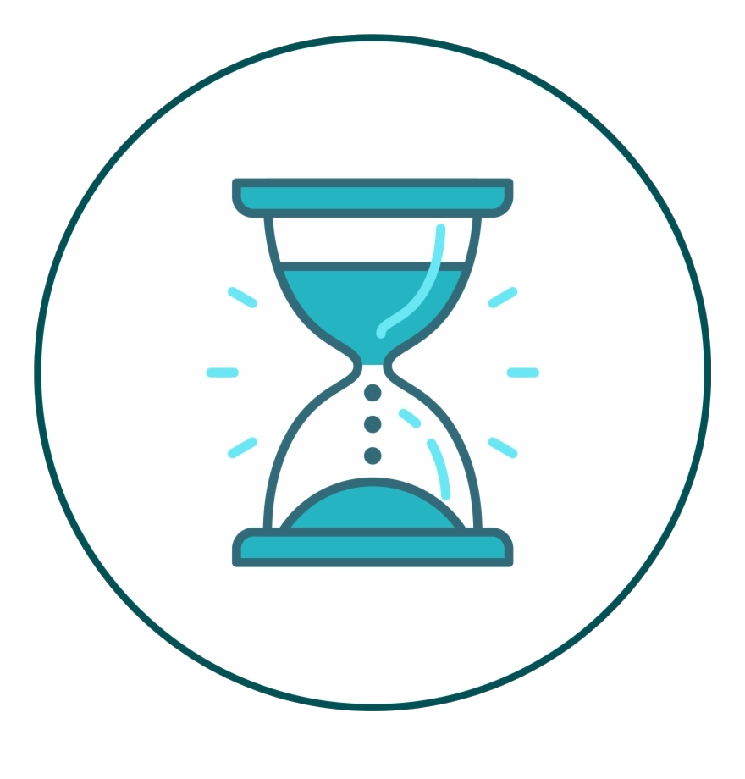

How is the app original?
No simple method/app to determine mental health conditions without consulting a doctor, or reading pages of papers
Not only does this app solve that, but it also outputs helpful healthy remedies that do not need the prescription of medical drugs or therapy
The app saves lots of time compared to having to read papers and articles
Any concerns? A helpful peer to peer chat room is designed to help the patient concerns. We provide a large chat group for mental health concerns compiled in one space. There are apps like reddit, but the patient still has to do research on the type of sub reddit to ask where our app is specifically made for just mental health
Notes:
In depth rubric point: Originality

Slide 4
Demo
Note: Learning is a scoring rubric “Did the team go outside of their comfort zone?” , so maybe talk about some team struggles in the presentation as well
Notes:
The user can currently enter in symptoms and get tips on how to mitigate them, although we wanted to implement a system where after the first assessment, the app also asks users if they have been acting on that plan and which parts they like / dislike, and the app can improve on that feedback. This feedback will modify the plan accordingly, and help users feel better over time. However, we did not manage to make it this far. The app also features a peer-to-peer chat feature, allowing users to anonymously vent to other users about their life, implementing a pseudo-group counseling feature as well.

Slide 5
Find Our Project At:
https://github.com/thesixtium/CYCC_2021

